Slide 1
Data Analysis in R
REU Data Carpentry Workshop
June 27th-28th
Elizabeth McDaniel, University of Wisconsin-Madison

Slide 2
After this lesson, you will be able to:
Use RStudio for writing R scripts
Implement the basic building blocks of an R script
Load your data into R
Manipulate data within R

Slide 3
Getting Started
Understand the difference between an Rscript and RStudio
Identify the different panels of an Rstudio window
Use Rstudio to find help on R functions
Describe how to troubleshoot problems with the wider R community in different settings

Slide 4
What is R?
“R” refers to both the programming language itself, and the software platform to interpret scripts written in it

Slide 5
Why learn R?
Less pointing and clicking involved
Writing scripts makes analyses more reproducible than clicking a series of buttons
Interdisciplinary (field-specific extensions or packages) for genomics, statistical simulations, etc.
Takes data of all shapes and sizes
Produce high-quality graphics without $$$
Large, welcoming, open source community always developing new packages

Slide 6
What is RStudio?
Rstudio is an Integrated Development Environment (IDE) for working with R
Can write code, navigate files, view variables you created, and inspect plots within RStudio
Lots of other IDEs that can suit a wide variety of programming languages

Slide 7
The RStudio Interface

Slide 8
The RStudio Interface

Slide 9
The RStudio Interface

Slide 10
The RStudio Interface

Slide 11
The RStudio Interface

Slide 12
Your Working Directory

Slide 13
Working in RStudio
Start RStudio
File > New Project > New Directory
Enter a name for the new folder, which will be your working directory
Click Create Project
Notes:
After explain steps, switch to RStudio

Slide 14
How do I find help?
Built-In RStudio help interface
Notes:
After explain steps, switch to RStudio

Slide 15
The RStudio Interface

Slide 16
The RStudio Interface

Slide 17
How do I find help?
Google is a great place to start!
…and more!
Notes:
After explain steps, switch to RStudio

Slide 18
What information do I include when I ask for help?
Make your code human-readable
Include the output of your session info, which includes information about your platform, versions of R and packages you are using
Notes:
After explain steps, switch to RStudio

Slide 19
Getting Started
Understand the difference between an Rscript and RStudio
Identify the different panels of an Rstudio window
Use Rstudio to find help on R functions
Describe how to troubleshoot problems with the wider R community

Slide 20
Introduction to R
Terminology:
object
assign
call
function
arguments
options

Slide 21
Introduction to R
Assign values and names to objects in R
Use comments to give future you/collaborators helpful information
Solve arithmetic operations in R
Call functions and use arguments to change default parameters
Inspect vectors and manipulate their content
Subset and extract values from vectors
Analyze vectors with missing data

Slide 22
Objects
Assign a value:
Give a name to the object
Use the <- assignment operator
Can be any name (with no spaces!), but cannot start with a number. Names are case sensitive. Cannot use a fundamental function (if, else, for) as an object name
Notes:
Do arithmetic, but want to save some values, make those values, then perform arithmetic on the values

Slide 23
Comments
“Your closest collaborator is you six months ago,
but you don’t reply to emails.
- Mark Holder”
- Karl Broman

Slide 24
Comments
Leave yourself useful notes about why you wrote lines of code a certain way (you won’t remember…trust me)
The comment character in R (and most programming languages) is the # symbol
Notes:
ctrl+shit+c to comment/uncomment a block of code

Slide 25
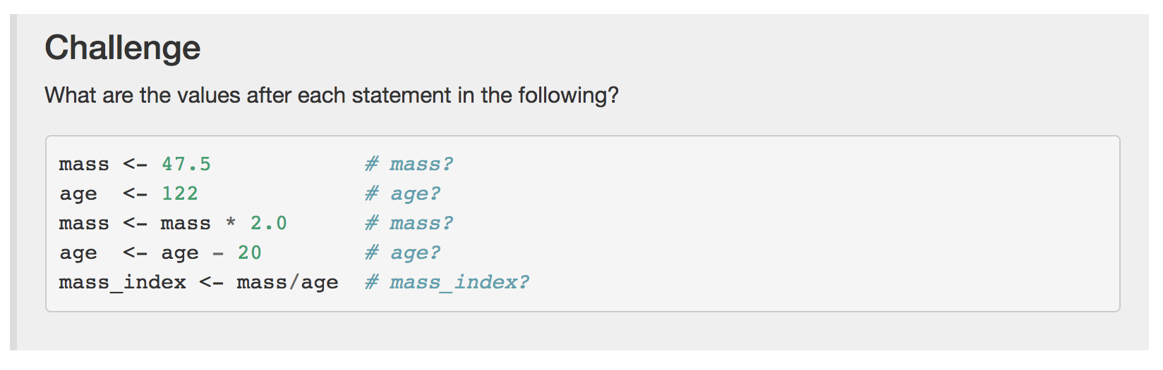
Challenge #1
Notes:
ctrl+shit+c to comment/uncomment a block of code

Slide 26
Vector
Most common data type in R
Composed of a series of values, either numbers or characters
Assign a series of values to a vector using the c() function, which combines the arguments to form a vector
Notes:
assign series of values to a vector, numbers and then characters, must have quotes
can get the length, how many arguments/values in a vector
class of the same type
add new elements to the vector
typeof to check what type of data your vector is

Slide 27
Subsetting Vectors
Extract one or several specific values from a vector
Provide an indices with brackets
Notes:
animals <- c(“mouse”, “rat”, “dog”, “cat”)
animals[2]
animals[c(3,2)]
start counting at position 1

Slide 28
Functions
Pre-packaged or “canned” scripts with complex set of commands and arguments
Notes:
round
sqrt

Slide 29
Conditional Subsetting
TRUE or FALSE logical factors
Combining multiple tests
& = both conditions are satisfied
| = one OR the other condition is satisfied
%in% test if any elements of a search vector are found
Notes:
is it greater than a certain amount

Slide 30
Missing Data
R was designed to analyze datasets, which may sometimes have missing data
Missing data in vectors is represented as NA
Notes:
ignore missing values

Slide 31
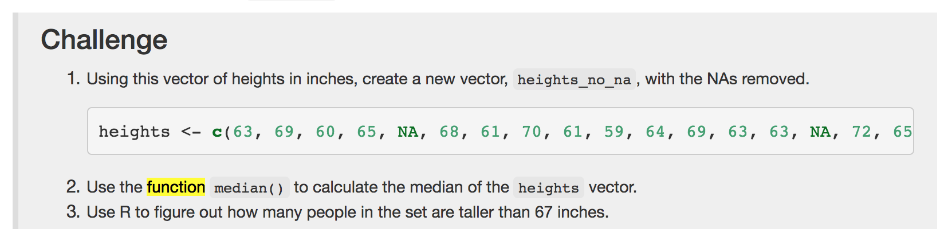
Challenge #2
Notes:
ignore missing values

Slide 32
Introduction to R
Terminology:
object
assign
call
function
arguments
options

Slide 33
Introduction to R
Assign values and names to objects in R
Use comments to give future you/collaborators helpful information
Solve arithmetic operations in R
Call functions and use arguments to change default parameters
Inspect vectors and manipulate their content
Subset and extract values from vectors
Analyze vectors with missing data
Notes:
take a break

Slide 34
Break
1 red sticky for something to improve
1 green sticky for something you liked during the session

Slide 35
Loading Data into R
Terminology:
Data frame
Factor
String

Slide 36
Loading Data into R
Load external data from a .csv file into a data frame
Describe what a data frame is
Summarize the contents of a data frame
Use indexing to subset specific parts of a data frame
Describe a factor
Reorder and rename factors

Slide 37
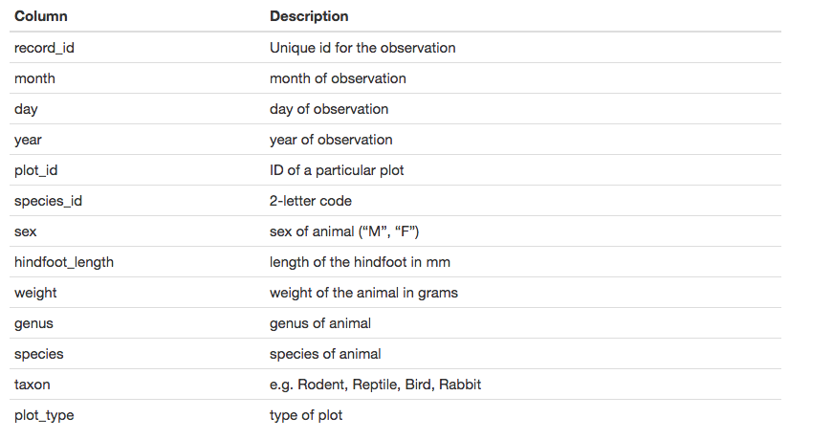
Survey Data
Studying species repartition and weight of animals caught in plots in our study area
Notes:
download, survey assign, head

Slide 38
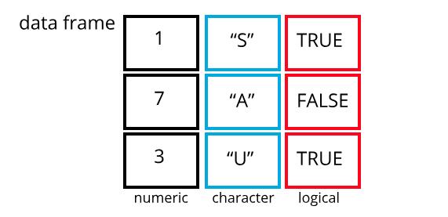
Data Frames
Data structures for tabular data, further used for statistics and plotting
Representation of data in the format of a table, columns are vectors with the same length, and contains the same type of data
Notes:
inspect the data frame
dimensions, nrow, ncol, size
head, tail to look at content
names – colnames or rownames
summaries: str or summary statistics

Slide 39
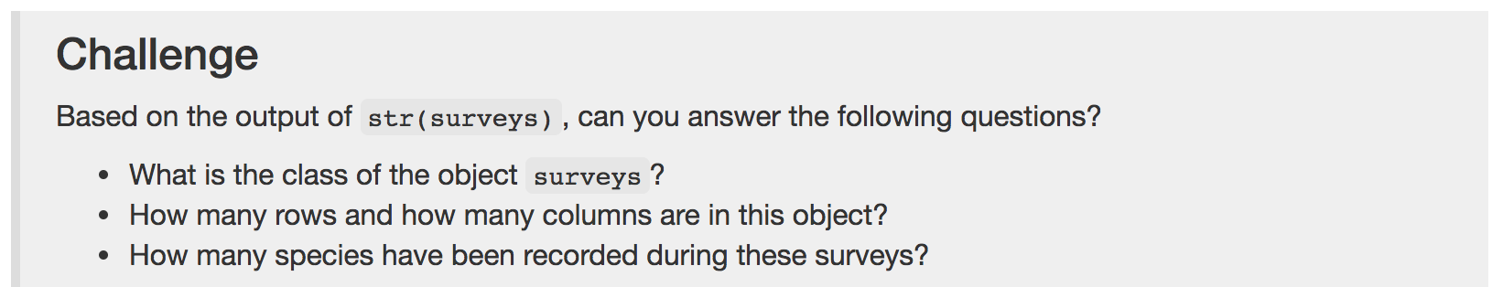
Challenge #3
Notes:
getting different elements of the dataframe
exclude with –
subset wby column name, “species_id” or $species_id

Slide 40
Indexing and Subsetting Data Frames
Survey data frame contains rows and columns = 2 dimensions
Extract information from the data frame, need to specify “coordinates”
Row numbers come first, then the column number
Notes:
getting different elements of the dataframe
exclude with –
subset wby column name, “species_id” or $species_id

Slide 41
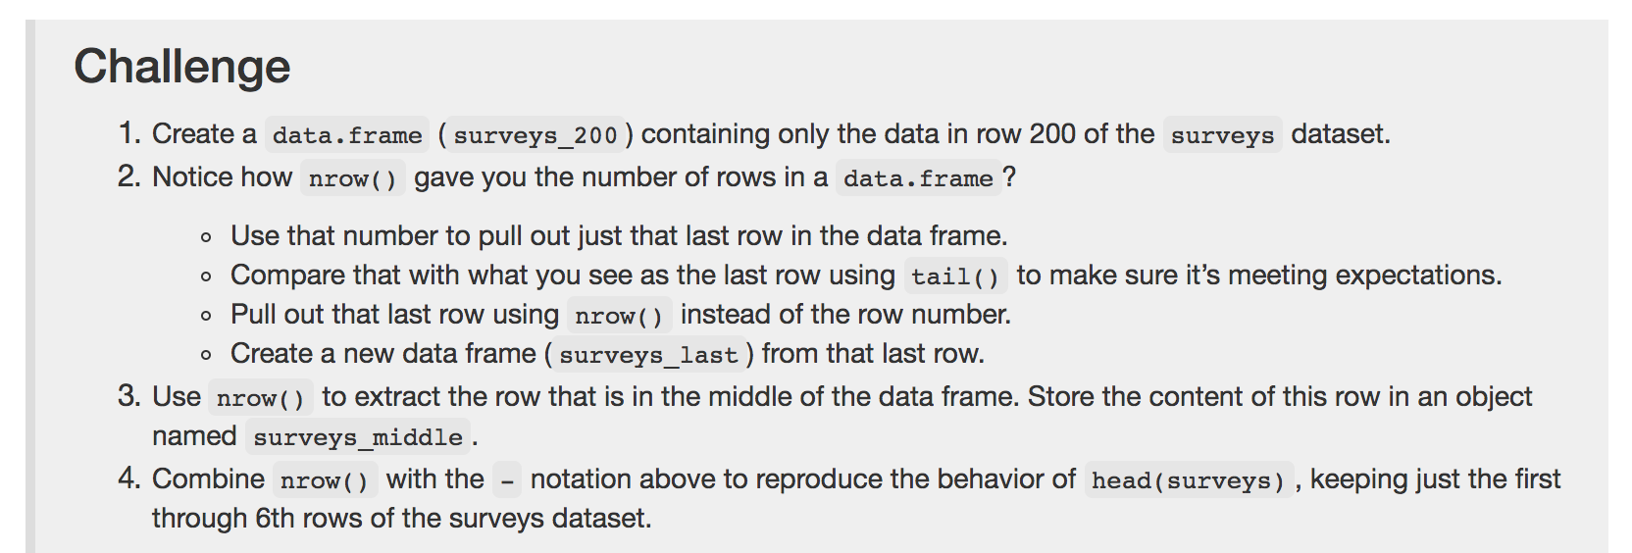
Challenge #4
Notes:
getting different elements of the dataframe
exclude with –
subset wby column name, “species_id” or $species_id

Slide 42
Factors
Factors represent categorical data
Several of the columns of our surveys data frame contain integers
However, columns such as genus, species, sex, plot_type… are categorical data
Factors are stored as integers with labels, and can either be ordered or unordered
Contain pre-defined set of values = levels
Notes:
sex <- factor(c(“male”, “female”))
levels or nlevels to get number of levels
convert factors, as.character
as.numeric

Slide 43
Loading Data into R
Terminology:
Data frame
Factor
String

Slide 44
Loading Data into R
Load external data from a .csv file into a data frame
Describe what a data frame is
Summarize the contents of a data frame
Use indexing to subset specific parts of a data frame
Describe a factor
Reorder and rename factors

Slide 45
Manipulating and Analyzing Data
Terminology:
pipe operator
split-apply-combine concept

Slide 46
Manipulating and Analyzing Data
Describe the purpose of the dplyr and tidyr packages
Select columns and filter rows
Use the pipe %>% operator
Understand and use the split-apply-combine concept for data analysis
Apply summary statistics and combine results
Describe the concept of wide and long table formats, and reshape data to and from these formats
Export data to a .csv file

Slide 47
Packages in R
Packages are extensions of R with additional functions that do not come in base R
Notes:
CRAN, install a package, have to load it every time you want to use it in a new script or session

Slide 48
tidyverse
The tidyverse is an umbrella of a suite of packages: tidyr, dplyr, ggplot2, and others.
Addresses 3 common issues when doing data analysis with functions in base R:
Results from a base R function depend on type of data
R expression used in a non standard way, can be confusing for new learners
Hidden arguments, contains default operations that new learners don’t have to be aware of
Notes:
CRAN, install a package, have to load it every time you want to use it in a new script or session

Slide 49
dplyr and tidyr Packages
dplyr is a package for manipulating tabular data easily
tidyr enables conversion between different data formats for plotting and analysis purposes

Slide 50
Tibbles
When a dataset is read into R using read_csv from the tidyverse package readr, the class of the data is a tbl_df or a “tibble”
This data structure is very similar to a data frame, with the differences are:
Displays data type of each column under its name, but only prints the first few rows of data and as many columns as will fit on the screen
Columns of class character are never converted into factors
Notes:
CRAN, install a package, have to load it every time you want to use it in a new script or session

Slide 51
Select Columns and Filter Rows
Selecting columns of a data frame
Filter rows by specific criteria
Notes:
CRAN, install a package, have to load it every time you want to use it in a new script or session

Slide 52
Multiple Operations
What if you want to select columns and filter rows at the same time?
You could do intermediate steps
Nested functions
Notes:
intermediate steps of filter by condition rows, and then select the columns you want
Both difficult to read

Slide 53
Pipes
Pass information from one program to another, useful for doing many operations on the same dataset
Pipes in R are represented by %>%, which the shortcut is Cmd+shift+M or Ctrl+Shift+M
Notes:
intermediate steps of filter by condition rows, and then select the columns you want
Both difficult to read

Slide 54
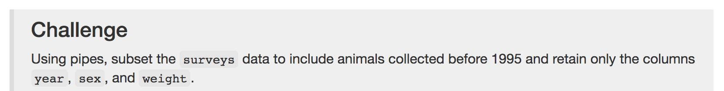
Challenge #5
Notes:
intermediate steps of filter by condition rows, and then select the columns you want
Both difficult to read

Slide 55
Mutate
Create new columns based on values in existing columns
Notes:
surveys %>% mutate(weight_kg = weight / 1000)

Slide 56
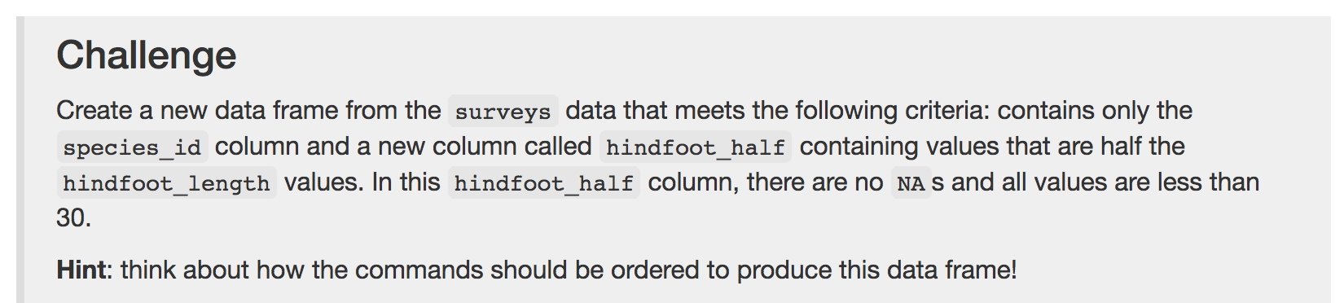
Challenge #6
Notes:
surveys %>% mutate(weight_kg = weight / 1000)

Slide 57
Split-apply-combine Approach
Many data analysis tasks can be tackled with the split-apply-combine approach
Split the data into groups
Apply some analysis to each group
Combine the results
Exemplified through the dplyr group_by() function
Notes:
group_by variable

Slide 58
Summarize
Group_by is often used with summarize to collapse each group into a single-row summary of that group
Takes as arguments as the categorical variables that you want to calculate summary statistics
Notes:
group_by variable

Slide 59
Challenge #7
Notes:
group_by variable

Slide 60
Reshaping data
From the Excel lesson we learned that data should be structured so that:
1. Each variable has its own column
2. Each observation has its own row
3. Each value has its own cell
4. Each type of observational unit forms a table
Notes:
look at the data
what if we want to look at it differently

Slide 61
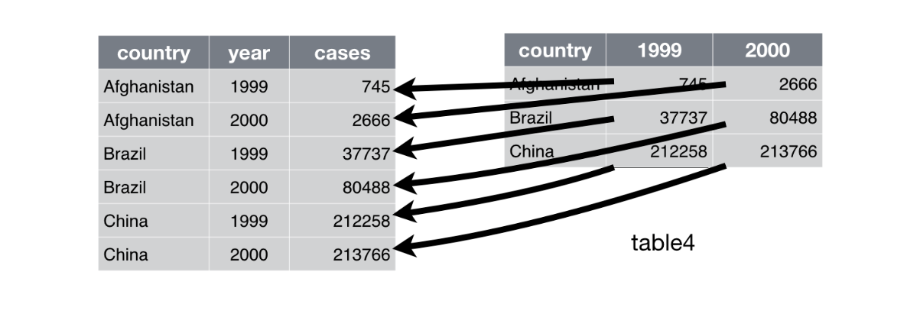
Gather
Notes:
gather columns into new pairs of variables, make wide tables more narrow and longer

Slide 62
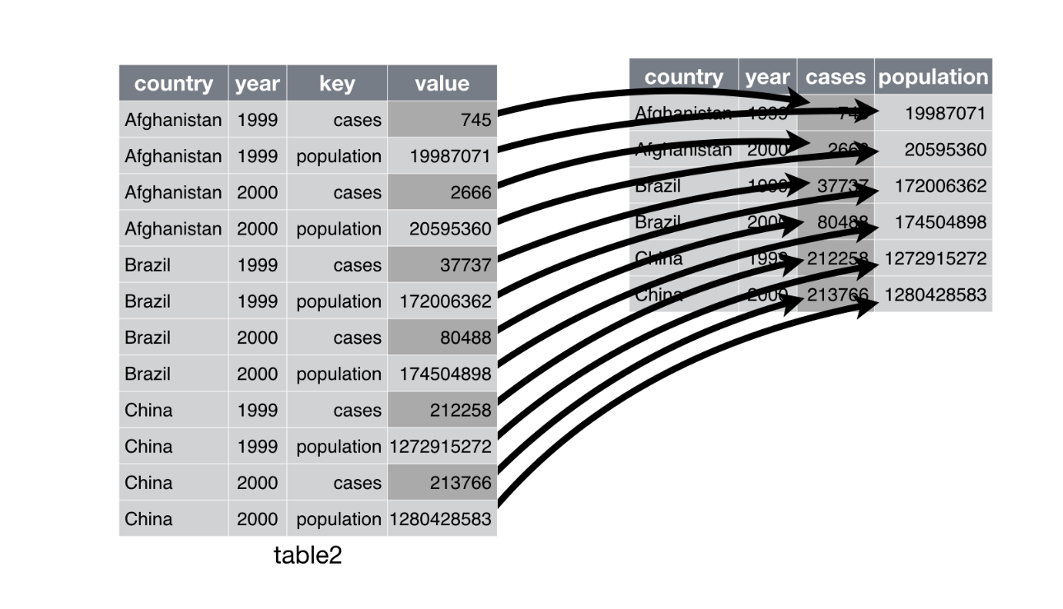
Spread
Notes:
use when an observation is spread across multiple rows, spread takes long tables shorter and wider

Slide 63
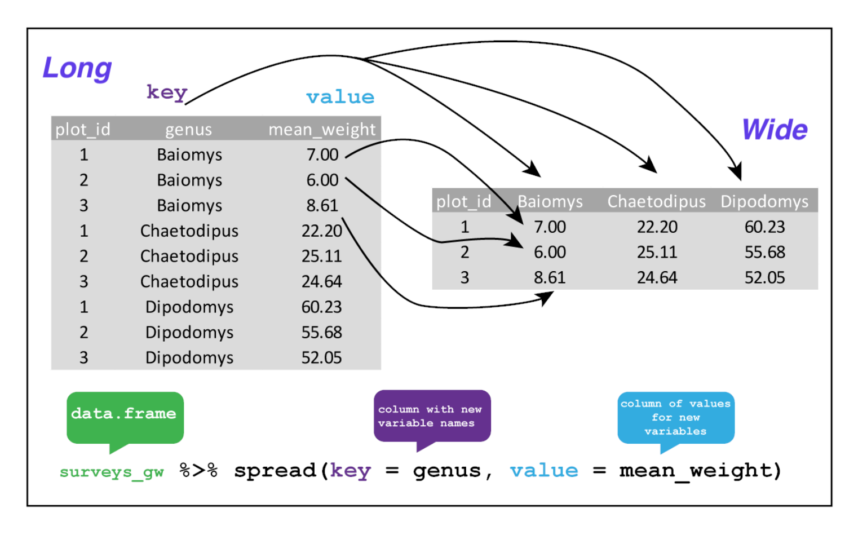
Spreading our data
Notes:
use when an observation is spread across multiple rows, spread takes long tables shorter and wider

Slide 64
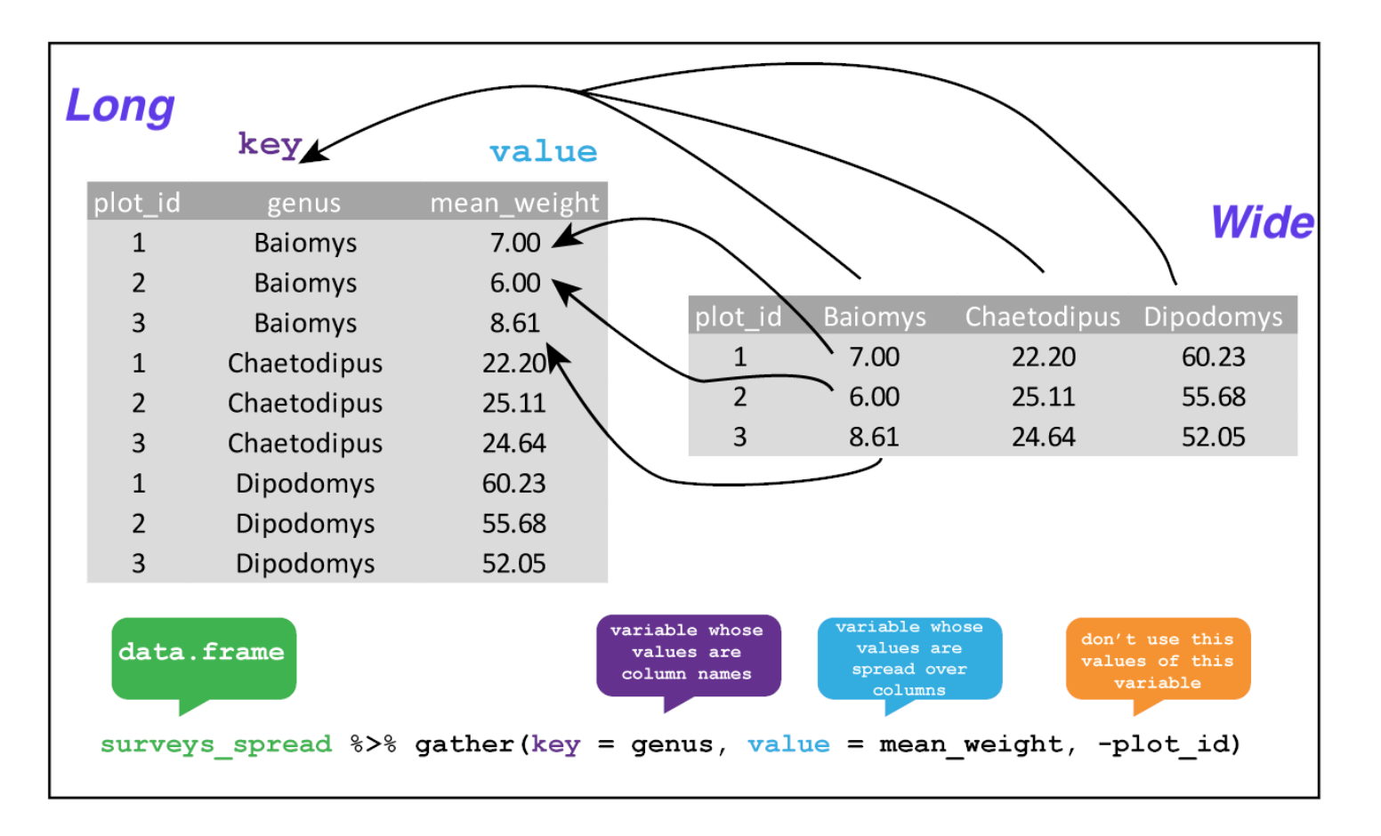
Gathering our data
Notes:
use when an observation is spread across multiple rows, spread takes long tables shorter and wider

Slide 65
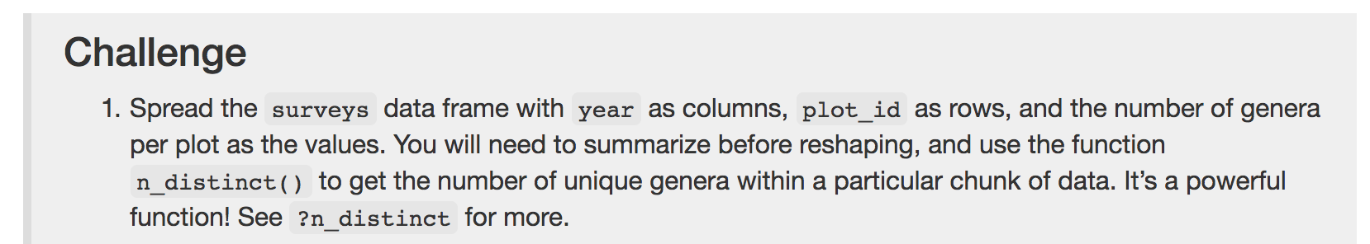
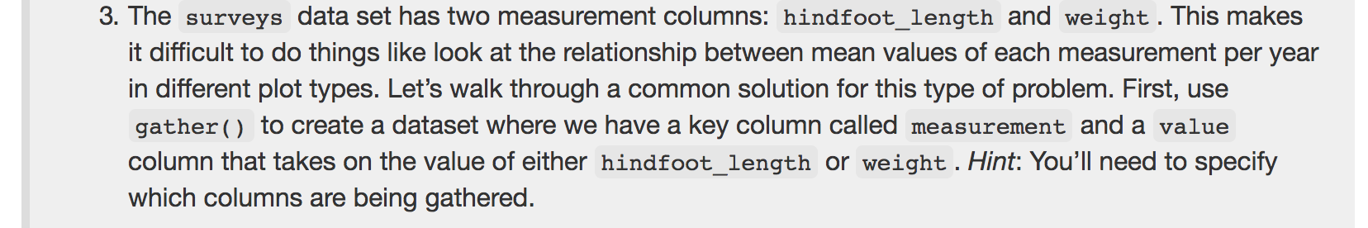
Challenge #8
Notes:
skip if no time or no enthusiasm

Slide 66
Exporting data
Generate CSV files from dataframes you created in R

Slide 67
Manipulating and Analyzing Data
Describe the purpose of the dplyr and tidyr packages
Select columns and filter rows
Use the pipe %>% operator
Understand and use the split-apply-combine concept for data analysis
Apply summary statistics and combine results
Describe the concept of wide and long table formats, and reshape data to and from these formats
Export data to a .csv file

